Slide 1


Introduction to Reinforcement Learning
Applied concepts for the practicing cognitive scientist
Sean Devine
[seandamiandevine@gmail.com]

Slide 2
Outline
Brief history of reinforcement learning algorithms
A (very) simple RL experiment
Brief overview of maximum likelihood estimation (MLE)
MLE of RL parameters (with Python)
Good estimation practices:
Effectively exploring the likelihood space
Parameter recovery
Predictive checking
Let’s try to understand this…
… and if we can get to this, cool bonus

Slide 3
Note!
Some of this may be complex on the first go, especially if you
Are not used to thinking in modeling terms
Are not familiar with programming at all
Some advice:
Don’t worry! Just focus on the big picture—the code can always come later :)
Ask questions!!!

Slide 4
1. A brief history of RL algorithms

Slide 5
The big question: How do we learn?
It all goes back to a man and his dog (Pavlov, 1927)
Key insight: reward predictions

Slide 6

The big question: How do we learn?
It all goes back to a man and his dog (Pavlov, 1927)

Slide 7

The big question: How do we learn?
It all goes back to a man and his dog (Pavlov, 1927)
At first, the dog does not predict anything from the bell…
?

Slide 8

The big question: How do we learn?
It all goes back to a man and his dog (Pavlov, 1927)
… and thus he is surprised by the food
!

Slide 9
The big question: How do we learn?
It all goes back to a man and his dog (Pavlov, 1927)
On the next trial…

Slide 10
The big question: How do we learn?
It all goes back to a man and his dog (Pavlov, 1927)
The dog hears the bell, but now expects something
🤔

Slide 11
The big question: How do we learn?
It all goes back to a man and his dog (Pavlov, 1927)
And is still surprised, but less, when the food appears
!

Slide 12
The big question: How do we learn?
It all goes back to a man and his dog (Pavlov, 1927)
On the next trial

Slide 13
The big question: How do we learn?
It all goes back to a man and his dog (Pavlov, 1927)
The dog now predicts the food when the bell chimes

Slide 14
The big question: How do we learn?
It all goes back to a man and his dog (Pavlov, 1927)
And he is now unsurprised by the appearance of the food
😒

Slide 15
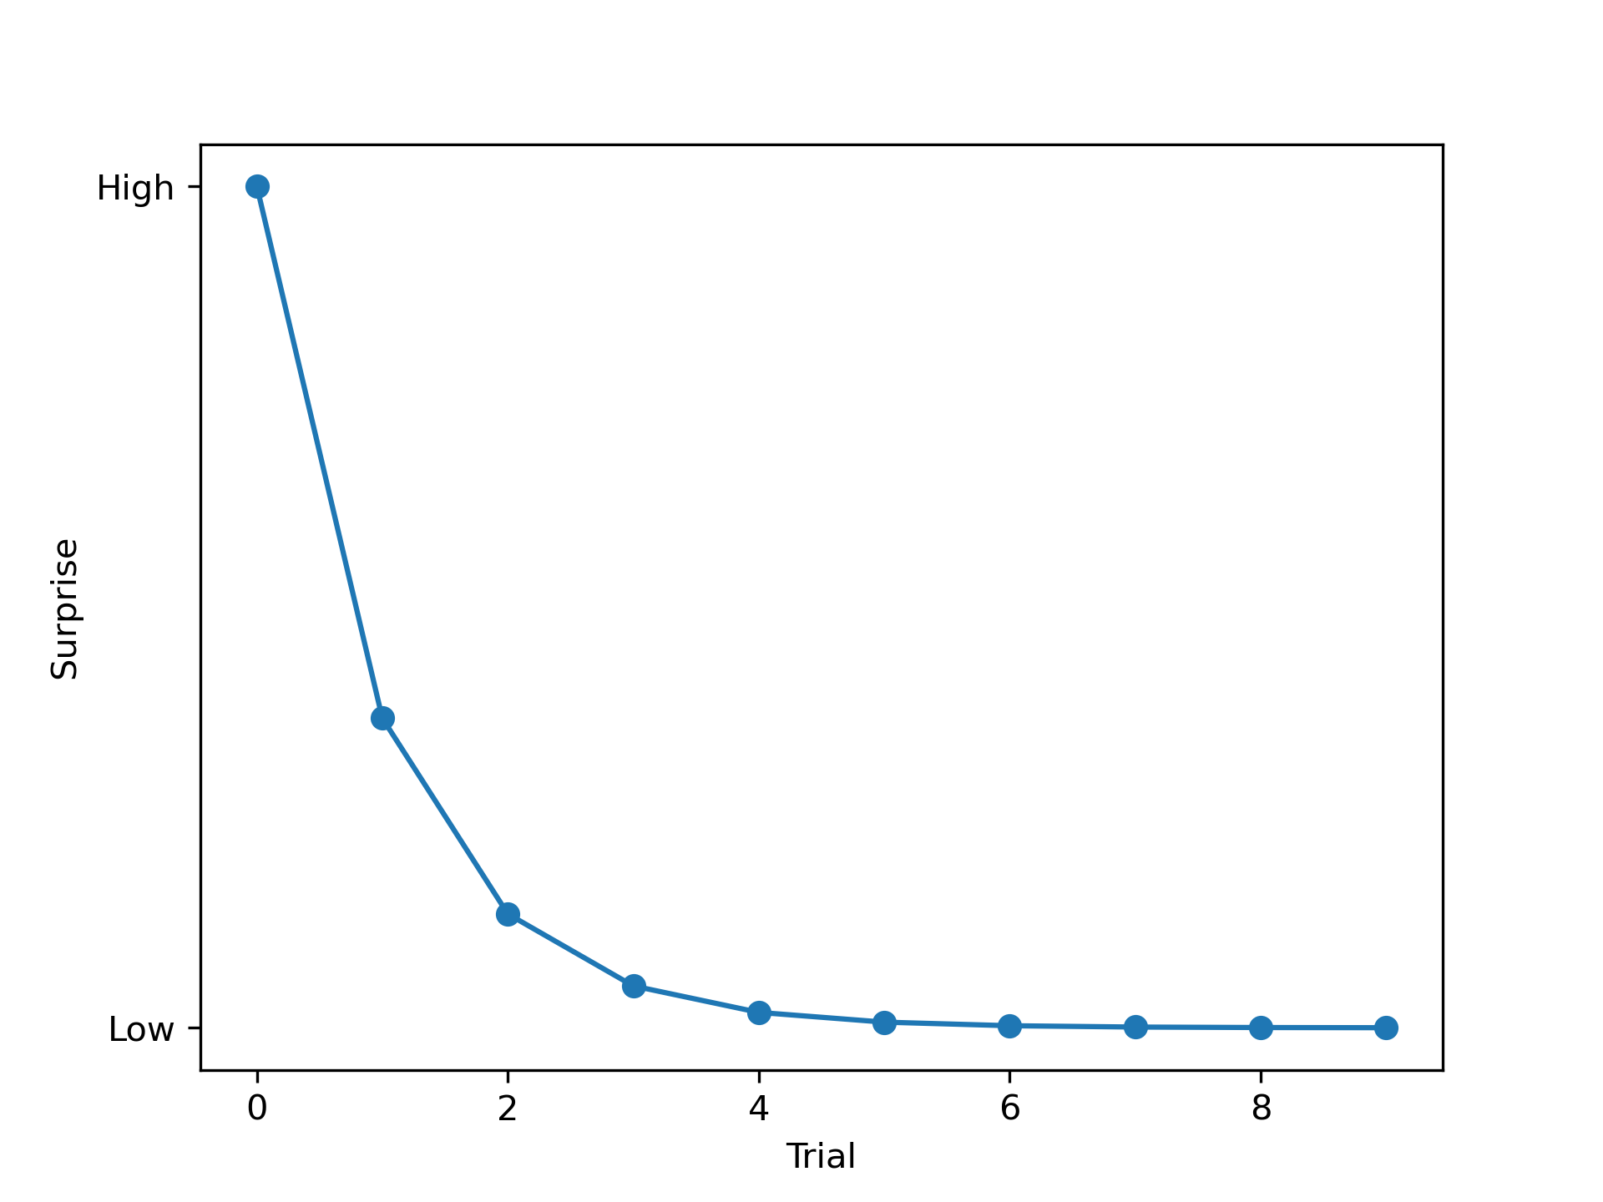
The big question: How do we learn?
It all goes back to a man and his dog (Pavlov, 1927)
Key insight: reward predictions
But what do we really mean by surprise
The degree to which our prediction matches the outcome
If our prediction ≠ outcome, we are surprised
If our prediction = outcome, we are not
And this is even more true if our predictions are strong!
Call this value the prediction error

Slide 16
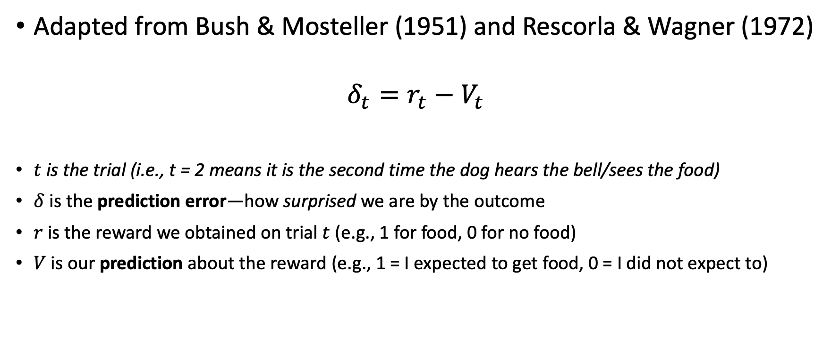
Formalizing the learning process
Adapted from Bush & Mosteller (1951) and Rescorla & Wagner (1972)
$$δ_{t}=r_{t}−V_{t}$$
$t$ is the trial (i.e., t = 2 means it is the second time the dog hears the bell/sees the food)
$δ$ is the prediction error—how surprised we are by the outcome
$r$ is the reward we obtained on trial $t$ (e.g., 1 for food, 0 for no food)
$V$ is our prediction about the reward (e.g., 1 = I expected to get food, 0 = I did not expect to)
Overall then, the prediction error is just the difference between what we got and what we expected to get

Slide 17
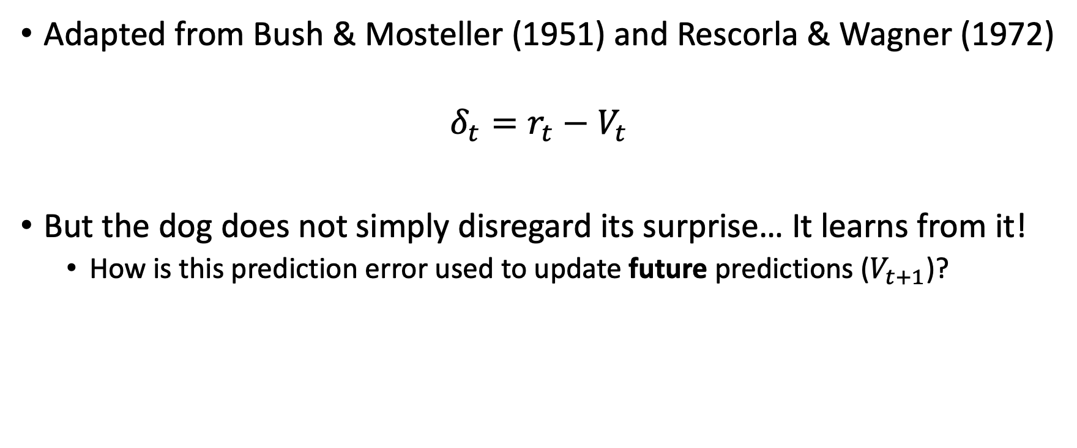
Formalizing the learning process
Adapted from Bush & Mosteller (1951) and Rescorla & Wagner (1972)
$$δ_{t}=r_{t}−V_{t}$$
But the dog does not simply disregard its surprise… It learns from it!
How is this prediction error used to update future predictions ($V_{t+1}$)?

Slide 18
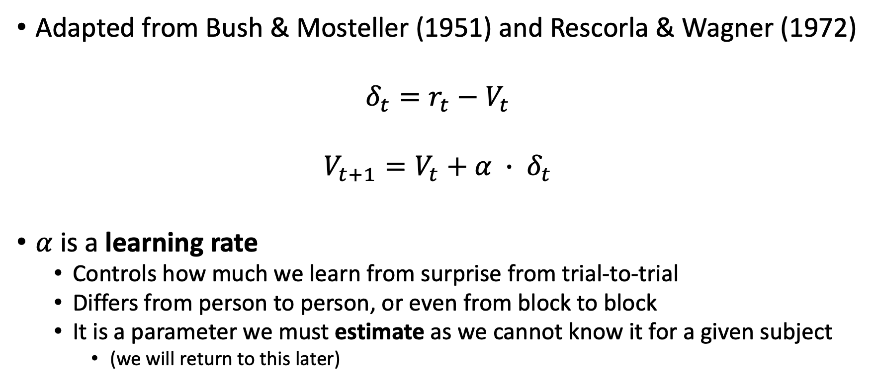
Formalizing the learning process
Adapted from Bush & Mosteller (1951) and Rescorla & Wagner (1972)
$$δ_{t}=r_{t}−V_{t}$$
$$V_{t+1}=V_{t}+α ∙ δ_{t}$$
$α$ is a learning rate
Controls how much we learn from surprise from trial-to-trial
Differs from person to person, or even from block to block
It is a parameter we must estimate as we cannot know it for a given subject
(we will return to this later)

Slide 19
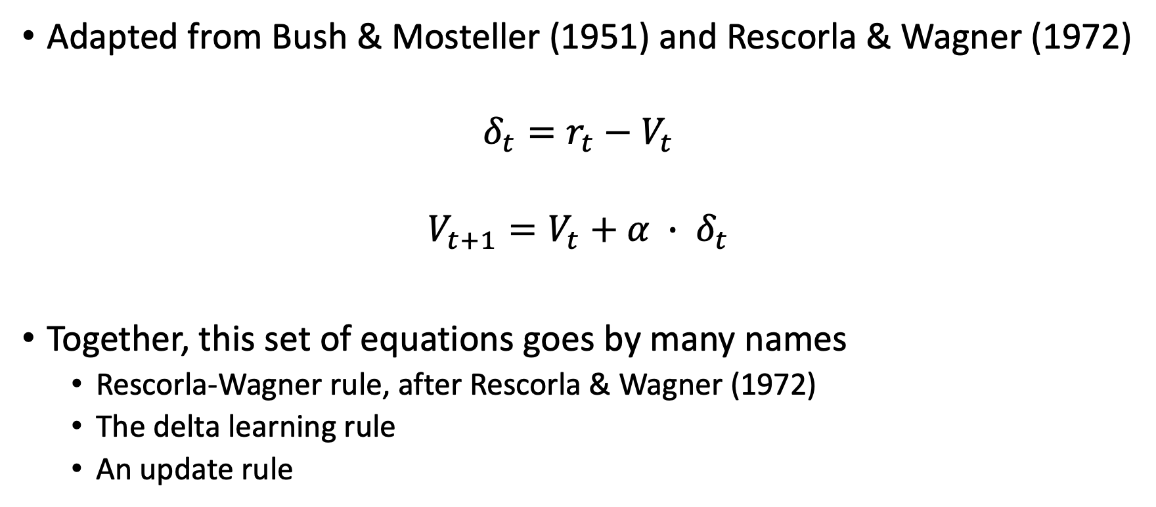
Formalizing the learning process
Adapted from Bush & Mosteller (1951) and Rescorla & Wagner (1972)
$$δ_{t}=r_{t}−V_{t}$$
$$V_{t+1}=V_{t}+α ∙ δ_{t}$$
Together, this set of equations goes by many names
Rescorla-Wagner rule, after Rescorla & Wagner (1972)
The delta learning rule
An update rule

Slide 20
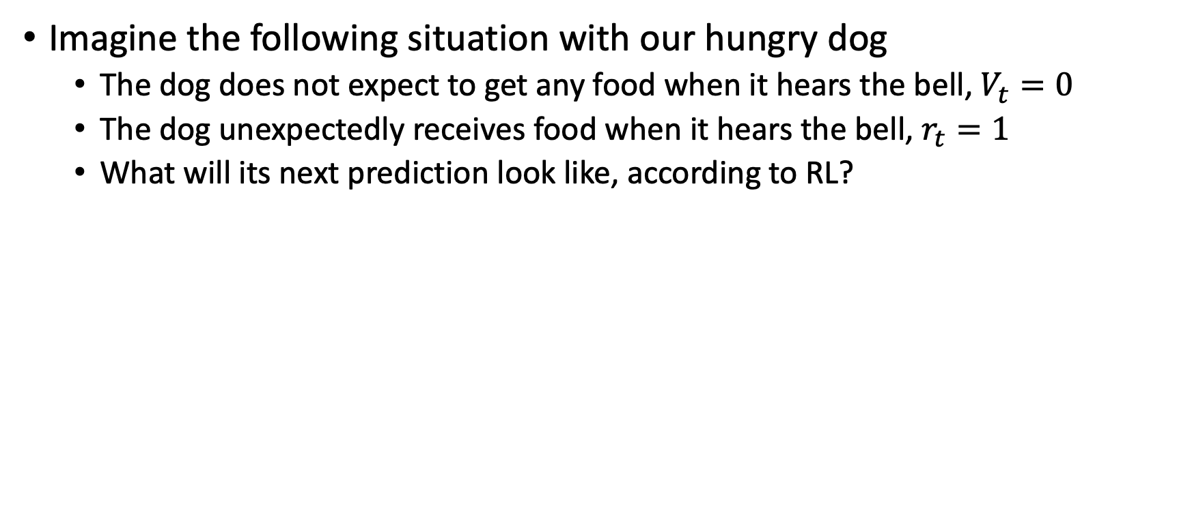
An example
Imagine the following situation with our hungry dog
The dog does not expect to get any food when it hears the bell, $V_{t}=0$
The dog unexpectedly receives food when it hears the bell, $r_{t}=1$
What will its next prediction look like, according to RL?

Slide 21
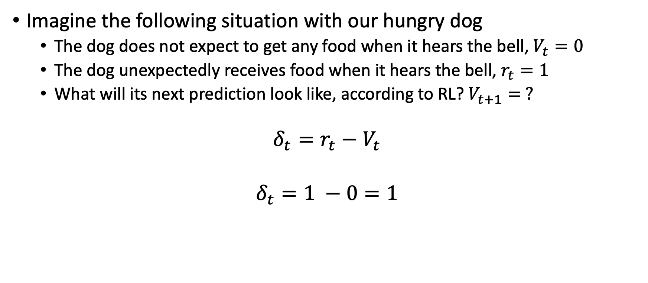
An example
Imagine the following situation with our hungry dog
The dog does not expect to get any food when it hears the bell, $V_{t}=0$
The dog unexpectedly receives food when it hears the bell, $r_{t}=1$
What will its next prediction look like, according to RL? $V_{t+1}= ?$
$$δ_{t}=r_{t}−V_{t}$$
$$δ_{t}=1 −0=1$$

Slide 22
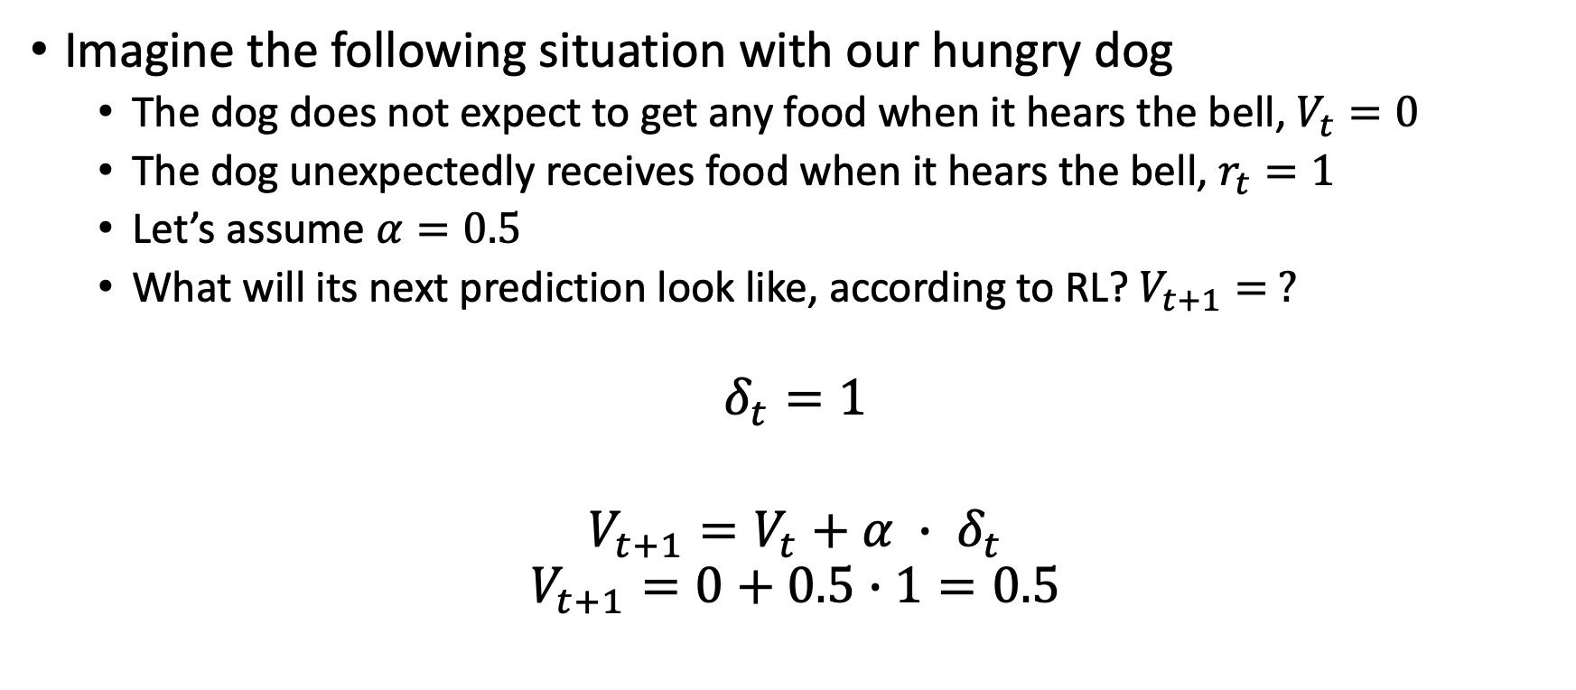
An example
Imagine the following situation with our hungry dog
The dog does not expect to get any food when it hears the bell, $V_{t}=0$
The dog unexpectedly receives food when it hears the bell, $r_{t}=1$
Let’s assume $α=0.5$
What will its next prediction look like, according to RL? $V_{t+1}= ?$
$$δ_{t}=1$$
$$V_{t+1}=V_{t}+α ∙ δ_{t}$$
$$V_{t+1}=0+0.5∙1=0.5$$

Slide 23
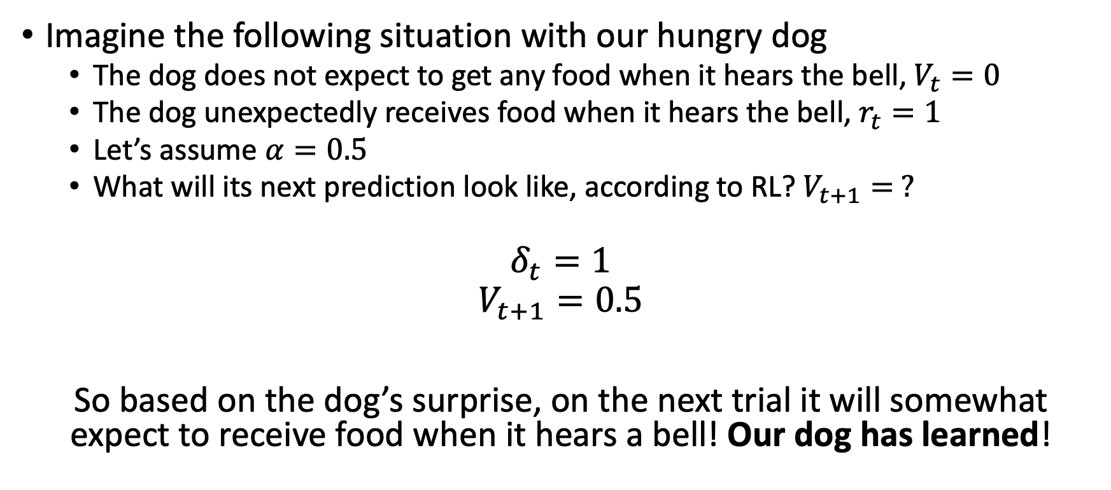
An example
Imagine the following situation with our hungry dog
The dog does not expect to get any food when it hears the bell, $V_{t}=0$
The dog unexpectedly receives food when it hears the bell, $r_{t}=1$
Let’s assume $α=0.5$
What will its next prediction look like, according to RL? $V_{t+1}= ?$
$$δ_{t}=1$$
$$V_{t+1}=0.5$$
So based on the dog’s surprise, on the next trial it will somewhat expect to receive food when it hears a bell! Our dog has learned!

Slide 24
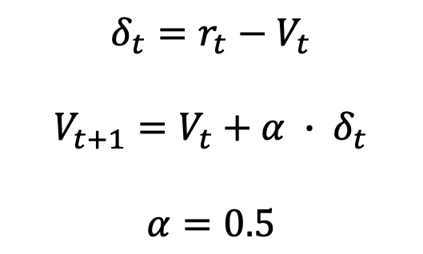
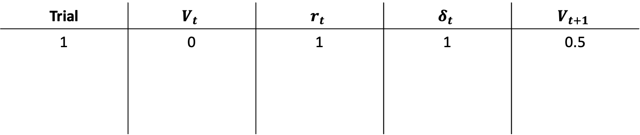
Extending the example
$$δ_{t}=r_{t}−V_{t}$$
$$V_{t+1}=V_{t}+α ∙ δ_{t}$$
$$α=0.5$$
Let’s extend our example over many trials
Trial | $$V_{t}$$ | $$r_{t}$$ | $$δ_{t}$$ | $$V_{t+1}$$
1 | 0 | 1 | 1 | 0.5

Slide 25
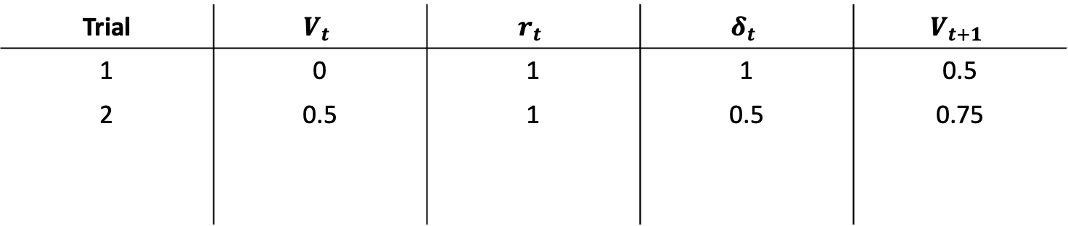
Extending the example
$$δ_{t}=r_{t}−V_{t}$$
$$V_{t+1}=V_{t}+α ∙ δ_{t}$$
$$α=0.5$$
Let’s extend our example over many trials
Trial | $$V_{t}$$ | $$r_{t}$$ | $$δ_{t}$$ | $$V_{t+1}$$
1 | 0 | 1 | 1 | 0.5
2 | 0.5 | 1 | 0.5 | 0.75

Slide 26
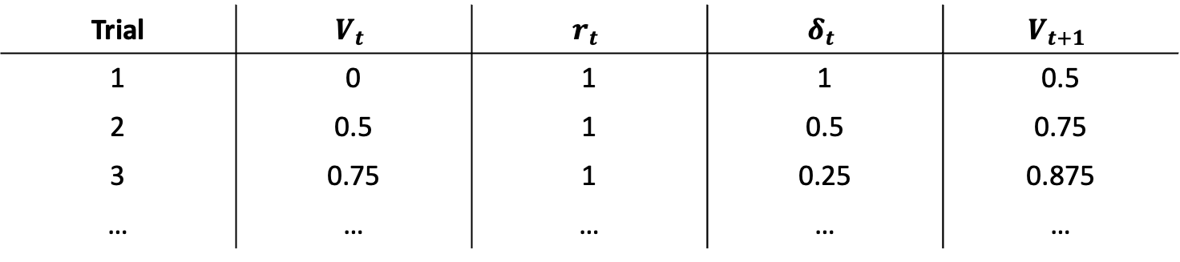
Extending the example
$$δ_{t}=r_{t}−V_{t}$$
$$V_{t+1}=V_{t}+α ∙ δ_{t}$$
$$α=0.5$$
Let’s extend our example over many trials
Trial | $$V_{t}$$ | $$r_{t}$$ | $$δ_{t}$$ | $$V_{t+1}$$
1 | 0 | 1 | 1 | 0.5
2 | 0.5 | 1 | 0.5 | 0.75
3 | 0.75 | 1 | 0.25 | 0.875
… | … | … | … | …

Slide 27
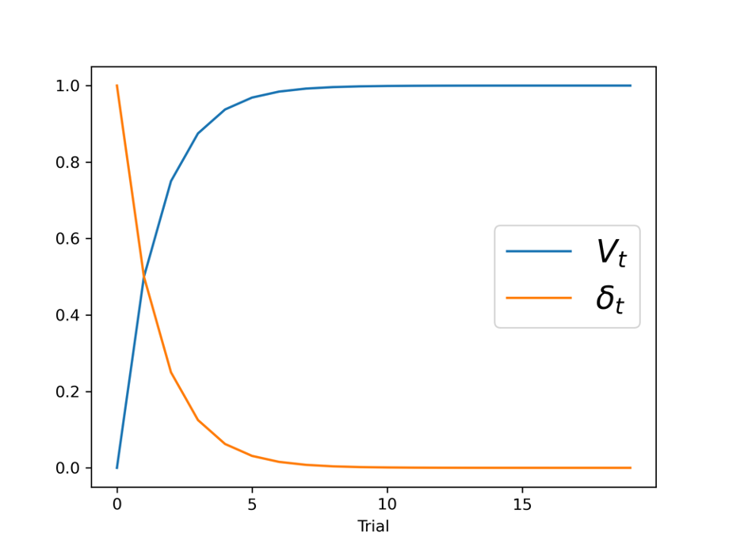
Extending the example
$$δ_{t}=r_{t}−V_{t}$$
$$V_{t+1}=V_{t}+α ∙ δ_{t}$$
$$α=0.5$$
Let’s extend our example over many trials
As rewards are continuously reinforced, the value of the stimulus (the bell) increases to some maximal value
As rewards repeat, surprise decreases, reducing prediction errors and halting learning

Slide 28
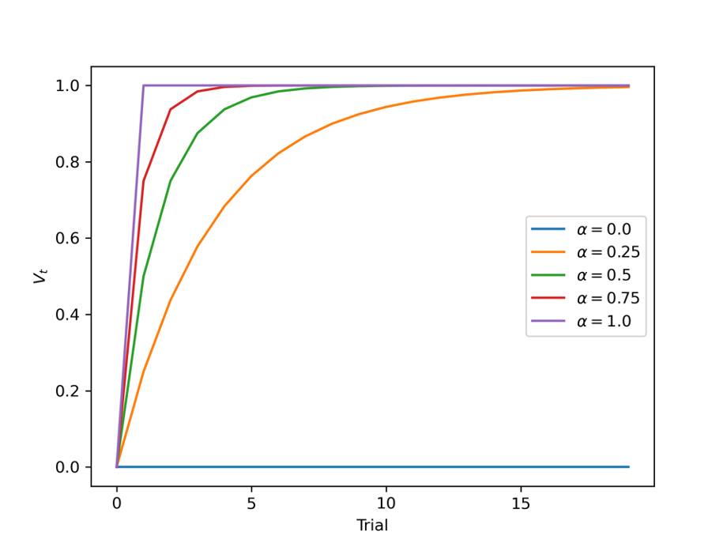

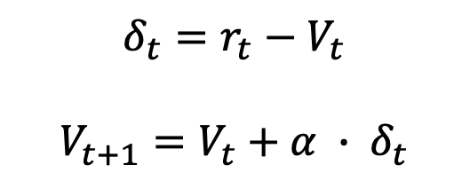
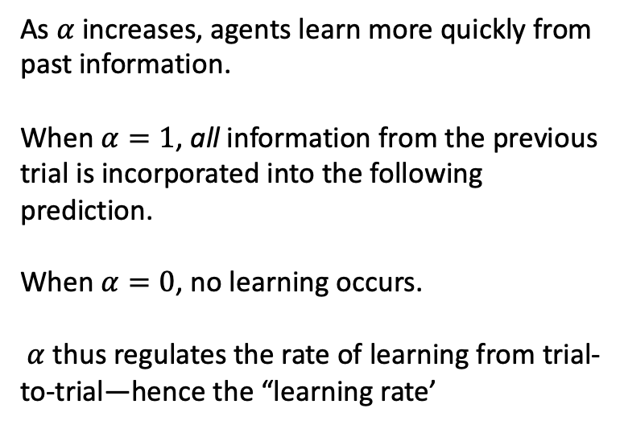
The role of $α$
$$δ_{t}=r_{t}−V_{t}$$
$$V_{t+1}=V_{t}+α ∙ δ_{t}$$
As $α$ increases, agents learn more quickly from past information.
When $α=1$, all information from the previous trial is incorporated into the following prediction.
When $α=0$, no learning occurs.
$α$ thus regulates the rate of learning from trial-to-trial—hence the “learning rate’

Slide 29
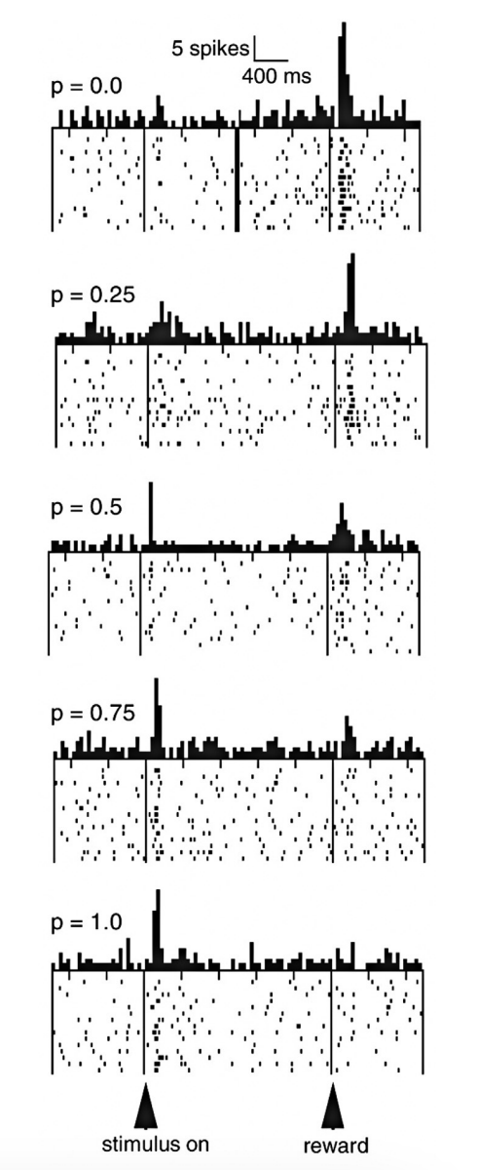
A (criminally) short history of RL and DA
Schultz (1986) found strong phasic activation of DA neurons in primates in accordance with the R-W rule
Fiorillo et al. (2003) extended these findings by manipulating the probabilities with which rewards followed visual stimuli and again found that the R-W explained DA neuron firing patterns
This work has been followed by a rush of empirical work providing further support and extending these early empirical finding
DA neurons selectively fire in anticipation of highly predictive stimulus cues

Slide 30
2. A (very) simple RL experiment

Slide 31
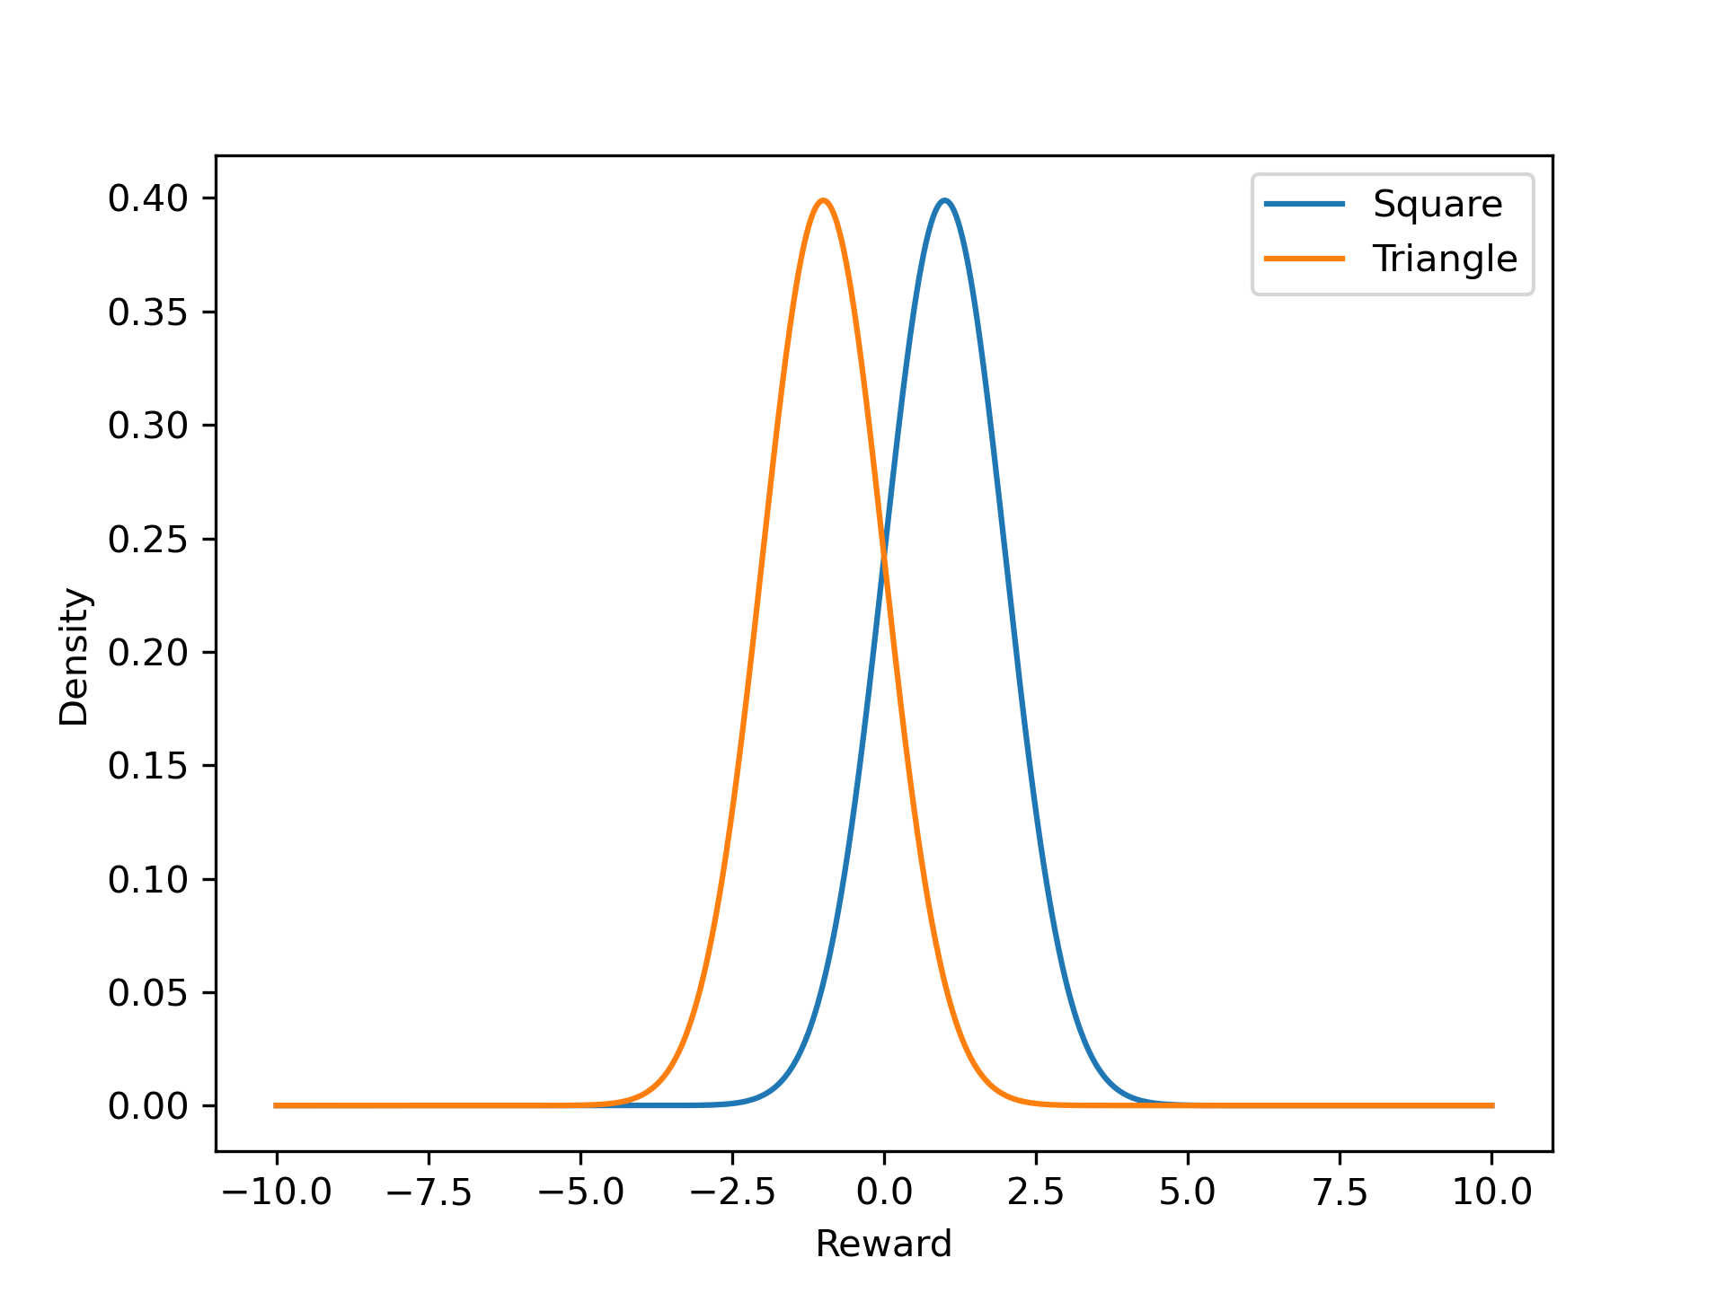
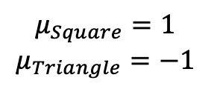
A typical RL choice paradigm
+ 1.5
- 1.1
$$μ_{Square}=1$$
$$μ_{Triangle}=−1$$

Slide 32
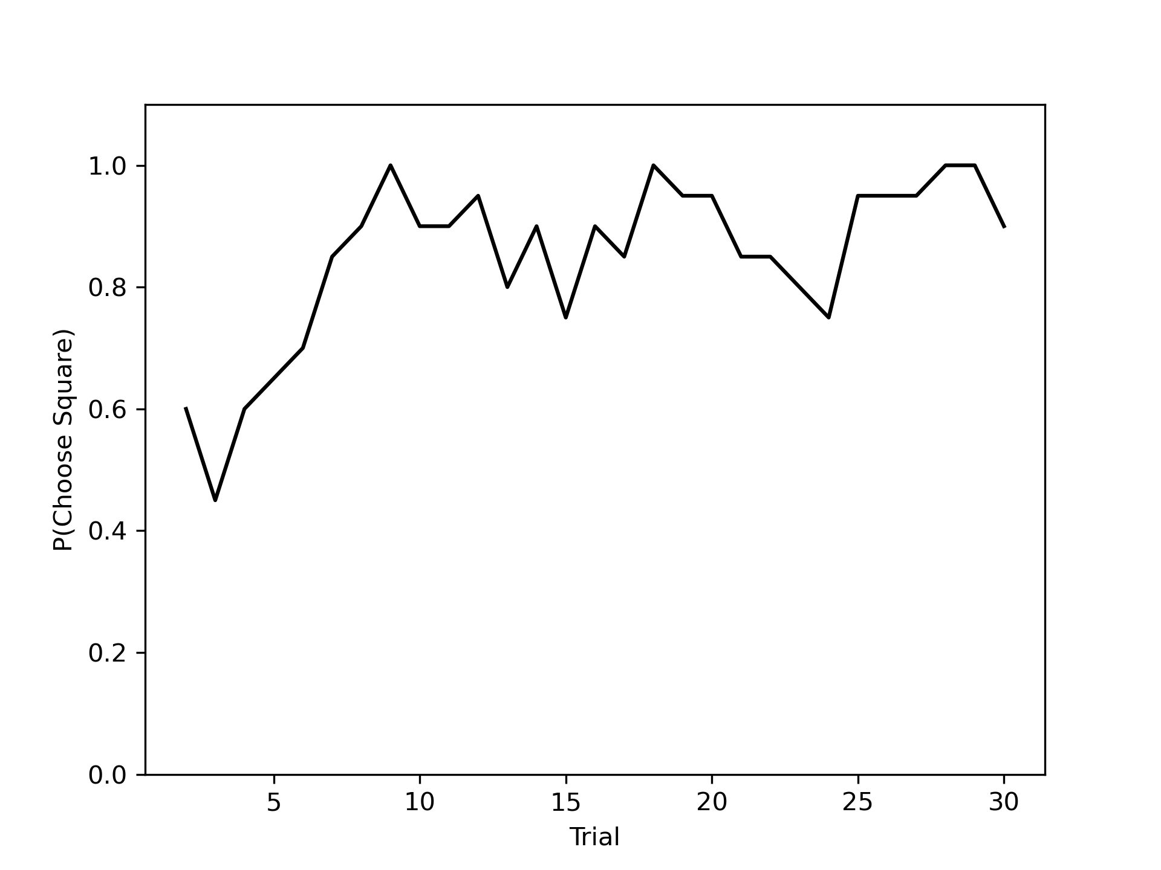
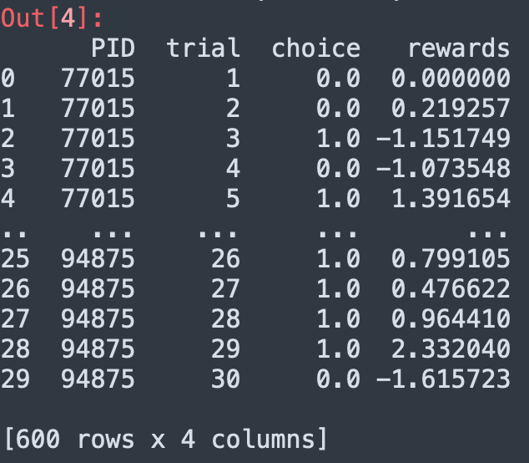
A typical RL choice paradigm
30 subjects, 30 trials each

Slide 33
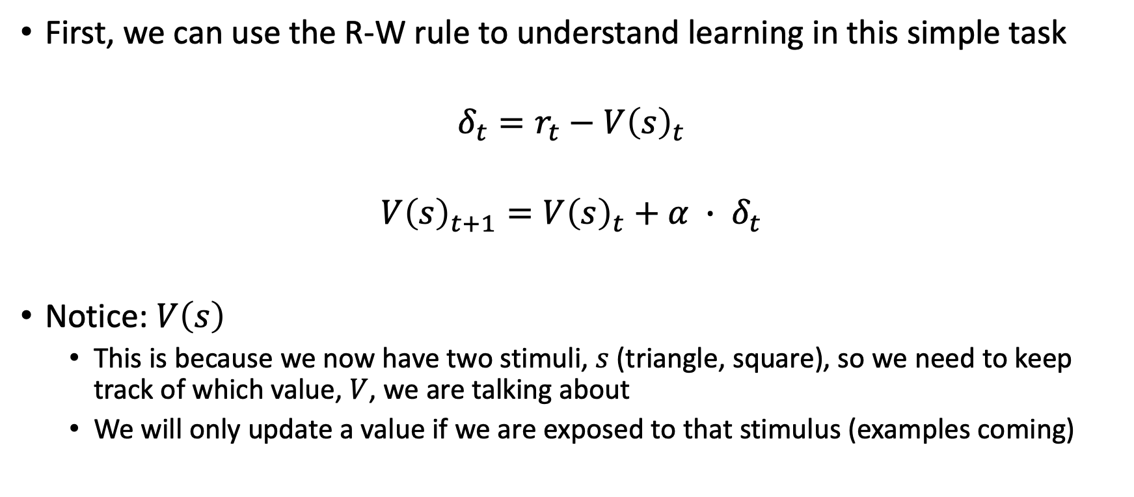
Modeling learning in this task
First, we can use the R-W rule to understand learning in this simple task
$$δ_{t}=r_{t}−V{\left(s\right)}_{t}$$
$$V{\left(s\right)}_{t+1}=V{\left(s\right)}_{t}+α ∙ δ_{t}$$
Notice: $V\left(s\right)$
This is because we now have two stimuli, $s$ (triangle, square), so we need to keep track of which value, $V$, we are talking about
We will only update a value if we are exposed to that stimulus (examples coming)

Slide 34
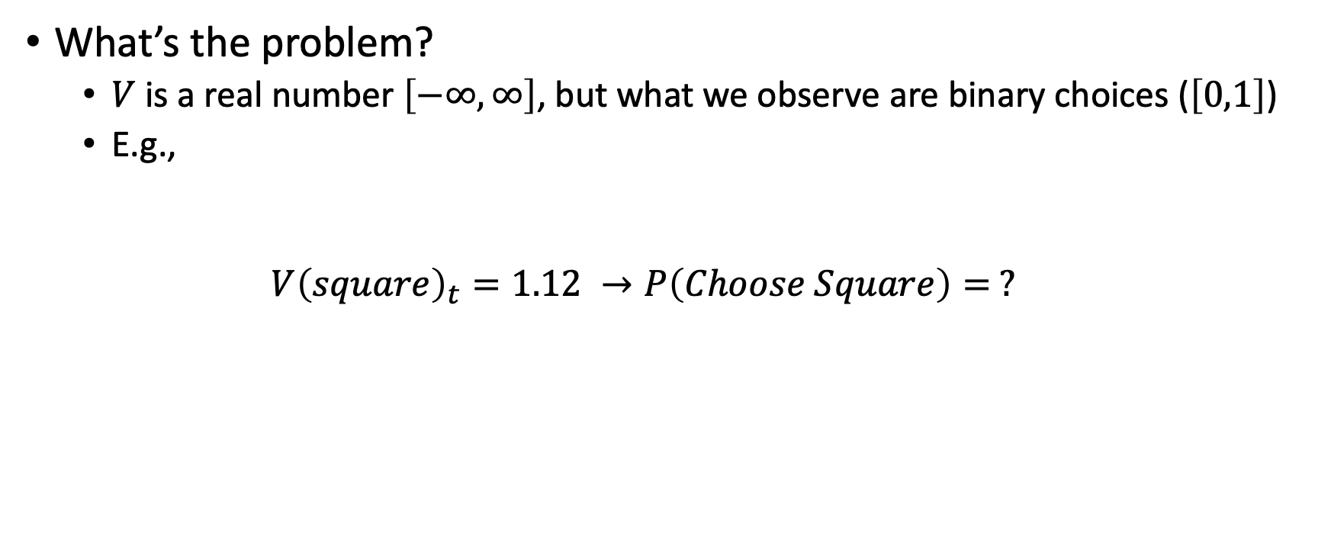
From value to choice
What’s the problem?
$V$ is a real number $\left[−∞, ∞\right]$, but what we observe are binary choices ($\left[0,1\right]$)
E.g.,
$$V{\left(square\right)}_{t}=1.12 →P\left(Choose Square\right)= ?$$

Slide 35
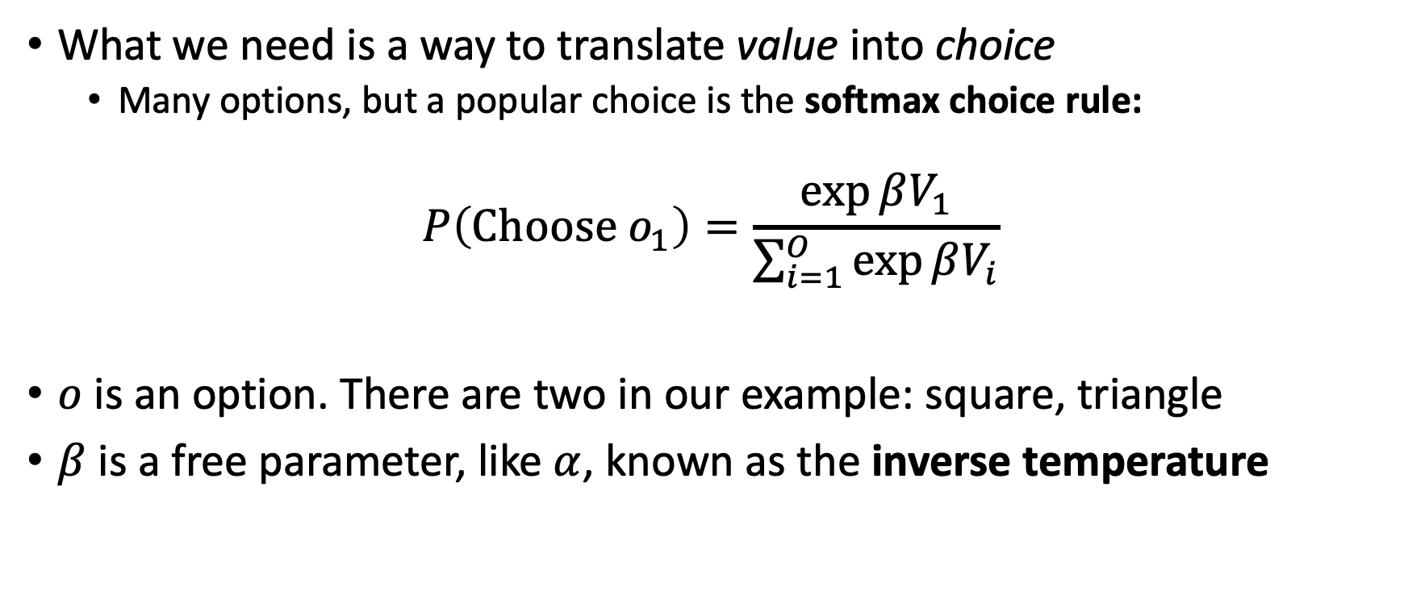
Modeling choice in this task
What we need is a way to translate value into choice
Many options, but a popular choice is the softmax choice rule:
$$P\left(Choose o_{1}\right)=\frac{\exp{βV_{1}}}{\sum_{i=1}^{O}{\exp{βV_{i}}}}$$
$o$ is an option. There are two in our example: square, triangle
$β$ is a free parameter, like $α$, known as the inverse temperature

Slide 36
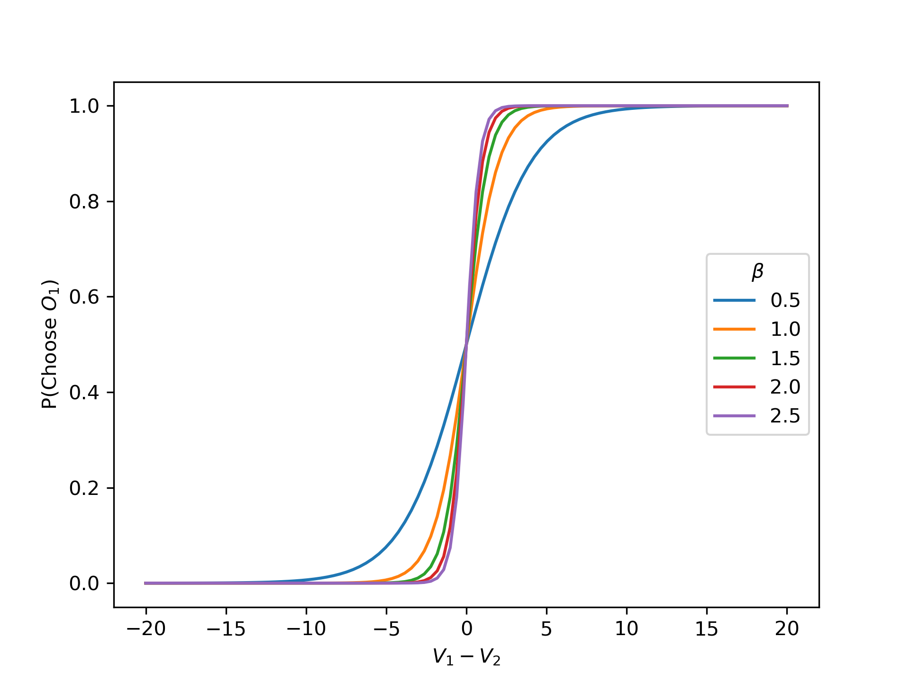

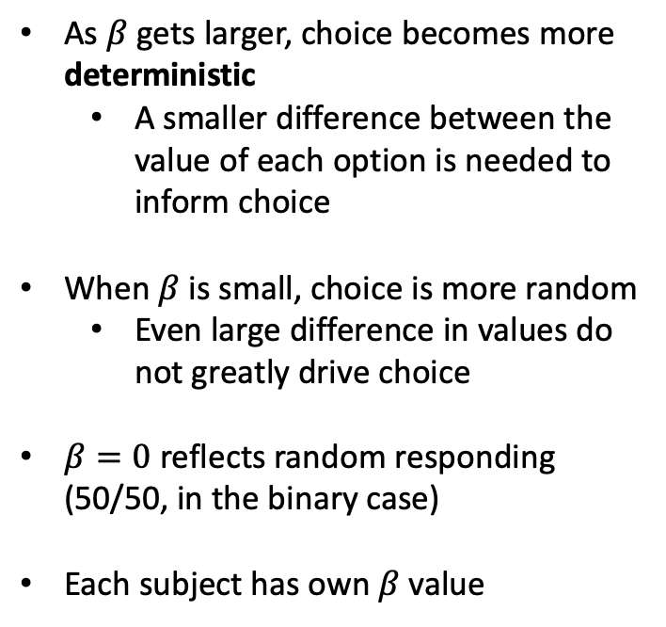
Understanding $β$
As $β$ gets larger, choice becomes more deterministic
A smaller difference between the value of each option is needed to inform choice
When $β$ is small, choice is more random
Even large difference in values do not greatly drive choice
$β=0$ reflects random responding (50/50, in the binary case)
Each subject has own $β$ value
← V1 is larger V2 is larger →

Slide 37
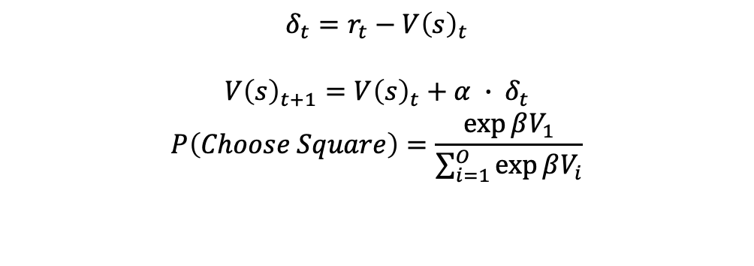
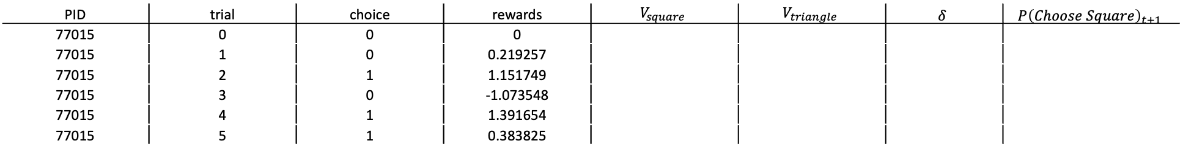
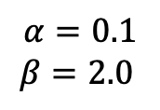
Putting it together
$$δ_{t}=r_{t}−V{\left(s\right)}_{t}$$
$$V{\left(s\right)}_{t+1}=V{\left(s\right)}_{t}+α ∙ δ_{t}$$
$$P\left(Choose Square\right)=\frac{\exp{βV_{1}}}{\sum_{i=1}^{O}{\exp{βV_{i}}}}$$
$$α=0.1$$
$$β=2.0$$
PID | trial | choice | rewards | $$V_{square}$$ | $$V_{triangle}$$ | $$δ$$ | $$P{\left(Choose Square\right)}_{t+1}$$
77015 | 0 | 0 | 0
77015 | 1 | 0 | 0.219257
77015 | 2 | 1 | 1.151749
77015 | 3 | 0 | -1.073548
77015 | 4 | 1 | 1.391654
77015 | 5 | 1 | 0.383825
0 = triangle
1 = square

Slide 38
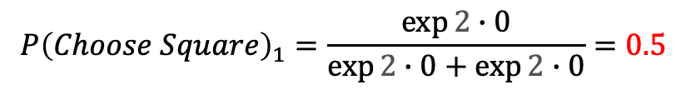
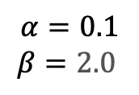
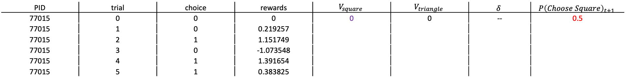
Putting it together
$$δ_{t}=r_{t}−V{\left(s\right)}_{t}$$
$$V{\left(s\right)}_{t+1}=V{\left(s\right)}_{t}+α ∙ δ_{t}$$
$$P\left(Choose Square\right)=\frac{\exp{βV_{1}}}{\sum_{i=1}^{O}{\exp{βV_{i}}}}$$
$$α=0.1$$
$$β=2.0$$
PID | trial | choice | rewards | $$V_{square}$$ | $$V_{triangle}$$ | $$δ$$ | $$P{\left(Choose Square\right)}_{t+1}$$
77015 | 0 | 0 | 0 | 0 | 0 | -- | 0.5
77015 | 1 | 0 | 0.219257
77015 | 2 | 1 | 1.151749
77015 | 3 | 0 | -1.073548
77015 | 4 | 1 | 1.391654
77015 | 5 | 1 | 0.383825
$$P{\left(Choose Square\right)}_{1}=\frac{\exp{2∙0}}{\exp{2∙0}+\exp{2∙0}}=0.5$$

Slide 39
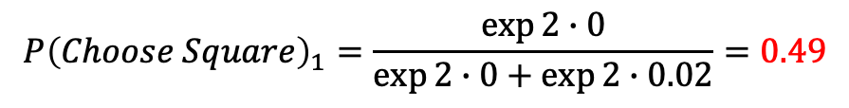
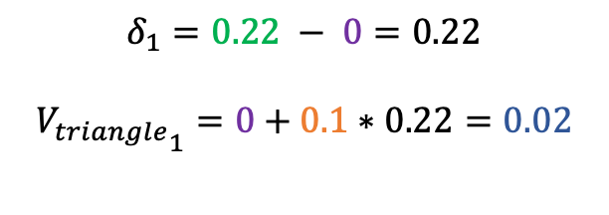
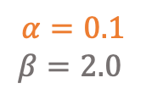
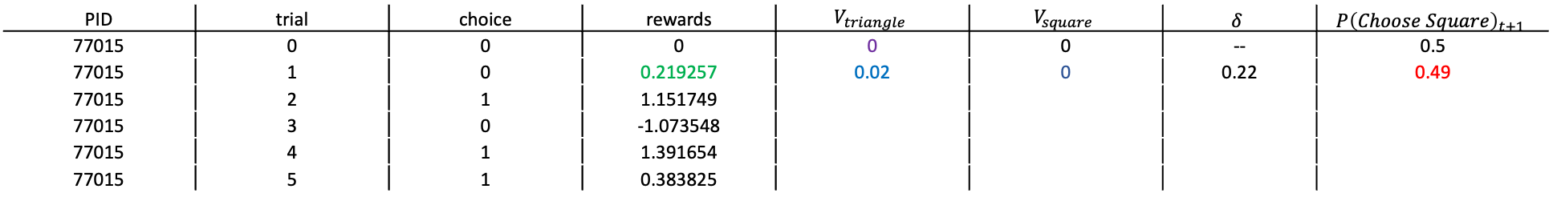
Putting it together
$$δ_{t}=r_{t}−V{\left(s\right)}_{t}$$
$$V{\left(s\right)}_{t+1}=V{\left(s\right)}_{t}+α ∙ δ_{t}$$
$$P\left(Choose Square\right)=\frac{\exp{βV_{1}}}{\sum_{i=1}^{O}{\exp{βV_{i}}}}$$
$$α=0.1$$
$$β=2.0$$
PID | trial | choice | rewards | $$V_{triangle}$$ | $$V_{square}$$ | $$δ$$ | $$P{\left(Choose Square\right)}_{t+1}$$
77015 | 0 | 0 | 0 | 0 | 0 | -- | 0.5
77015 | 1 | 0 | 0.219257 | 0.02 | 0 | 0.22 | 0.49
77015 | 2 | 1 | 1.151749
77015 | 3 | 0 | -1.073548
77015 | 4 | 1 | 1.391654
77015 | 5 | 1 | 0.383825
$$δ_{1}=0.22 − 0=0.22$$
$${V_{triangle}}_{1}=0+0.1∗0.22=0.02$$
$$P{\left(Choose Square\right)}_{1}=\frac{\exp{2∙0}}{\exp{2∙0}+\exp{2∙0.02}}=0.49$$

Slide 40

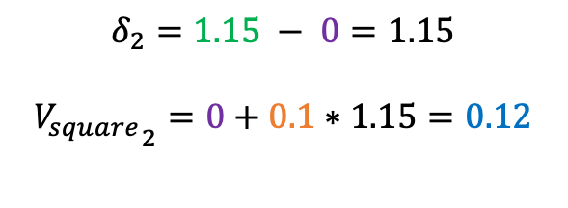
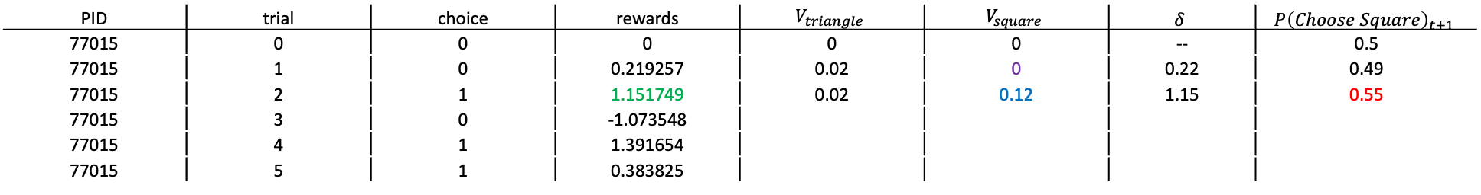
Putting it together
$$δ_{t}=r_{t}−V{\left(s\right)}_{t}$$
$$V{\left(s\right)}_{t+1}=V{\left(s\right)}_{t}+α ∙ δ_{t}$$
$$P\left(Choose Square\right)=\frac{\exp{βV_{1}}}{\sum_{i=1}^{O}{\exp{βV_{i}}}}$$
$$α=0.1$$
$$β=2.0$$
PID | trial | choice | rewards | $$V_{triangle}$$ | $$V_{square}$$ | $$δ$$ | $$P{\left(Choose Square\right)}_{t+1}$$
77015 | 0 | 0 | 0 | 0 | 0 | -- | 0.5
77015 | 1 | 0 | 0.219257 | 0.02 | 0 | 0.22 | 0.49
77015 | 2 | 1 | 1.151749 | 0.02 | 0.12 | 1.15 | 0.55
77015 | 3 | 0 | -1.073548
77015 | 4 | 1 | 1.391654
77015 | 5 | 1 | 0.383825
$$δ_{2}=1.15 − 0=1.15$$
$${V_{square}}_{2}=0+0.1∗1.15=0.12$$
$$P{\left(Choose Square\right)}_{1}=\frac{\exp{2∙0.12}}{\exp{2∙0.12}+\exp{2∙0.02}}=0.55$$

Slide 41

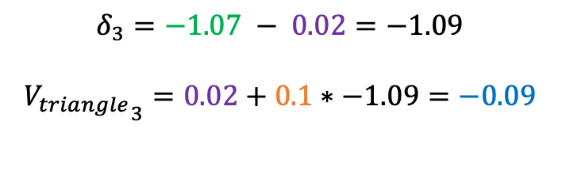
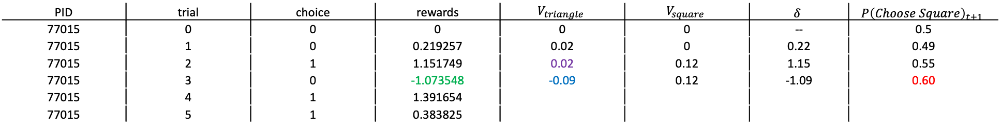
Putting it together
$$δ_{t}=r_{t}−V{\left(s\right)}_{t}$$
$$V{\left(s\right)}_{t+1}=V{\left(s\right)}_{t}+α ∙ δ_{t}$$
$$P\left(Choose Square\right)=\frac{\exp{βV_{1}}}{\sum_{i=1}^{O}{\exp{βV_{i}}}}$$
$$α=0.1$$
$$β=2.0$$
PID | trial | choice | rewards | $$V_{triangle}$$ | $$V_{square}$$ | $$δ$$ | $$P{\left(Choose Square\right)}_{t+1}$$
77015 | 0 | 0 | 0 | 0 | 0 | -- | 0.5
77015 | 1 | 0 | 0.219257 | 0.02 | 0 | 0.22 | 0.49
77015 | 2 | 1 | 1.151749 | 0.02 | 0.12 | 1.15 | 0.55
77015 | 3 | 0 | -1.073548 | -0.09 | 0.12 | -1.09 | 0.60
77015 | 4 | 1 | 1.391654
77015 | 5 | 1 | 0.383825
$$δ_{3}=−1.07 − 0.02=−1.09$$
$${V_{triangle}}_{3}=0.02+0.1∗−1.09=−0.09$$
$$P{\left(Choose Square\right)}_{1}=\frac{\exp{2∙0.12}}{\exp{2∙0.12}+\exp{2∙−0.09}}=0.60$$

Slide 42
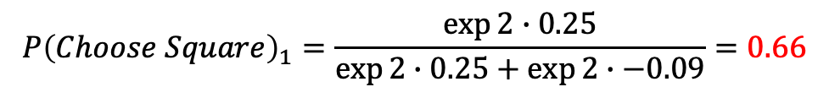
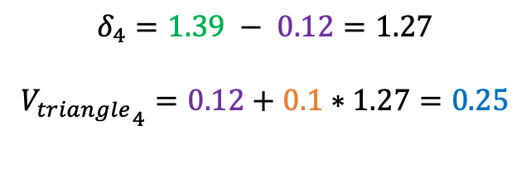
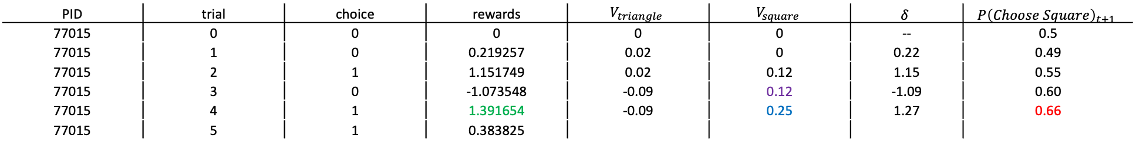
Putting it together
$$δ_{t}=r_{t}−V{\left(s\right)}_{t}$$
$$V{\left(s\right)}_{t+1}=V{\left(s\right)}_{t}+α ∙ δ_{t}$$
$$P\left(Choose Square\right)=\frac{\exp{βV_{1}}}{\sum_{i=1}^{O}{\exp{βV_{i}}}}$$
$$α=0.1$$
$$β=2.0$$
PID | trial | choice | rewards | $$V_{triangle}$$ | $$V_{square}$$ | $$δ$$ | $$P{\left(Choose Square\right)}_{t+1}$$
77015 | 0 | 0 | 0 | 0 | 0 | -- | 0.5
77015 | 1 | 0 | 0.219257 | 0.02 | 0 | 0.22 | 0.49
77015 | 2 | 1 | 1.151749 | 0.02 | 0.12 | 1.15 | 0.55
77015 | 3 | 0 | -1.073548 | -0.09 | 0.12 | -1.09 | 0.60
77015 | 4 | 1 | 1.391654 | -0.09 | 0.25 | 1.27 | 0.66
77015 | 5 | 1 | 0.383825
$$δ_{4}=1.39 − 0.12=1.27$$
$${V_{triangle}}_{4}=0.12+0.1∗1.27=0.25$$
$$P{\left(Choose Square\right)}_{1}=\frac{\exp{2∙0.25}}{\exp{2∙0.25}+\exp{2∙−0.09}}=0.66$$

Slide 43

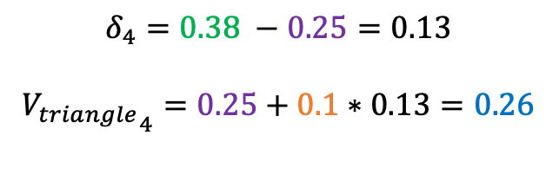
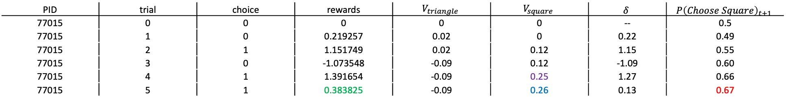
Putting it together
$$δ_{t}=r_{t}−V{\left(s\right)}_{t}$$
$$V{\left(s\right)}_{t+1}=V{\left(s\right)}_{t}+α ∙ δ_{t}$$
$$P\left(Choose Square\right)=\frac{\exp{βV_{1}}}{\sum_{i=1}^{O}{\exp{βV_{i}}}}$$
$$α=0.1$$
$$β=2.0$$
PID | trial | choice | rewards | $$V_{triangle}$$ | $$V_{square}$$ | $$δ$$ | $$P{\left(Choose Square\right)}_{t+1}$$
77015 | 0 | 0 | 0 | 0 | 0 | -- | 0.5
77015 | 1 | 0 | 0.219257 | 0.02 | 0 | 0.22 | 0.49
77015 | 2 | 1 | 1.151749 | 0.02 | 0.12 | 1.15 | 0.55
77015 | 3 | 0 | -1.073548 | -0.09 | 0.12 | -1.09 | 0.60
77015 | 4 | 1 | 1.391654 | -0.09 | 0.25 | 1.27 | 0.66
77015 | 5 | 1 | 0.383825 | -0.09 | 0.26 | 0.13 | 0.67
$$δ_{4}=0.38 −0.25=0.13$$
$${V_{triangle}}_{4}=0.25+0.1∗0.13=0.26$$
$$P{\left(Choose Square\right)}_{1}=\frac{\exp{2∙0.26}}{\exp{2∙0.26}+\exp{2∙−0.09}}=0.67$$

Slide 44
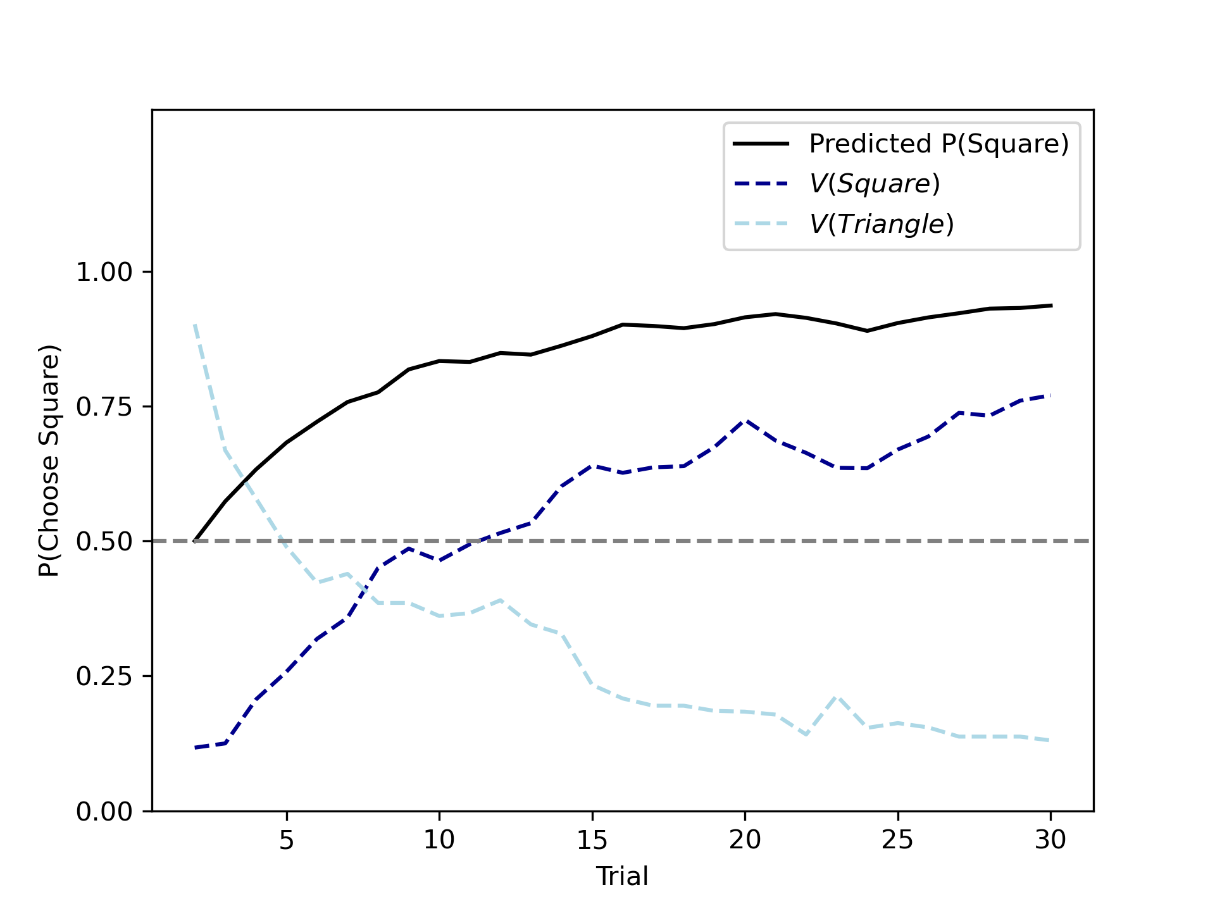
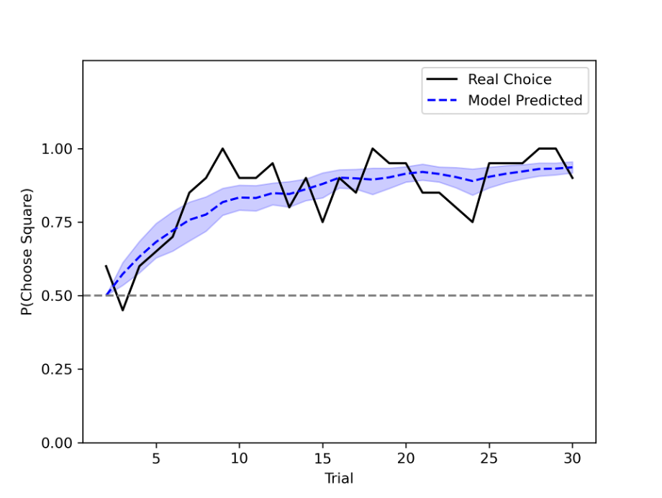
Putting it together
$$δ_{t}=r_{t}−V{\left(s\right)}_{t}$$
$$V{\left(s\right)}_{t+1}=V{\left(s\right)}_{t}+α ∙ δ_{t}$$
$$P\left(Choose Square\right)=\frac{\exp{βV_{1}}}{\sum_{i=1}^{O}{\exp{βV_{i}}}}$$

Slide 45
3. Overview of maximum likelihood estimation (MLE)

Slide 46
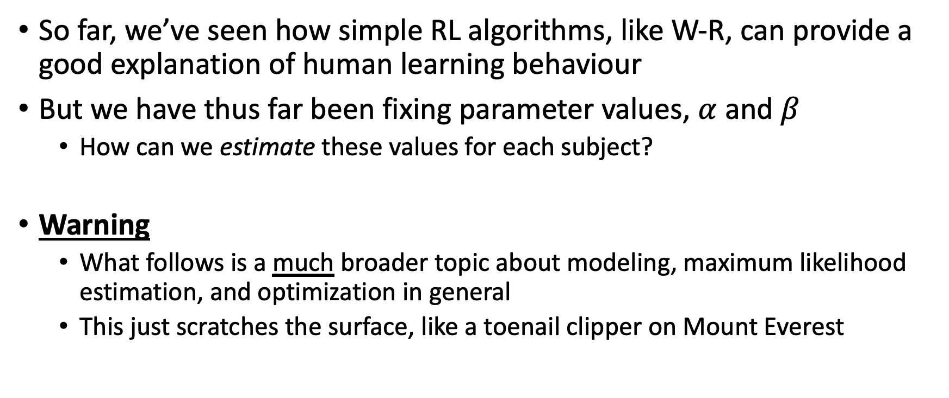
Recap
So far, we’ve seen how simple RL algorithms, like W-R, can provide a good explanation of human learning behaviour
But we have thus far been fixing parameter values, $α$ and $β$
How can we estimate these values for each subject?
Warning
What follows is a much broader topic about modeling, maximum likelihood estimation, and optimization in general
This just scratches the surface, like a toenail clipper on Mount Everest

Slide 47
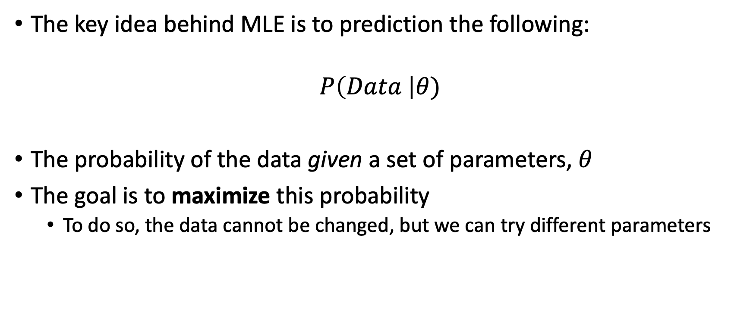
Maximum likelihood estimation
The key idea behind MLE is to prediction the following:
$$P\left(Data \right|θ)$$
The probability of the data given a set of parameters, $θ$
The goal is to maximize this probability
To do so, the data cannot be changed, but we can try different parameters

Slide 48


MLE with coin flips
A basic example: 7 heads (of state)
How likely is it that this is a fair coin?
Well, what do we mean by a “fair coin”?
A coin that, usually, lands on heads 50% of the time.
We can quantify this intuition statistically by assuming a probability distribution

Slide 49

MLE with coin flips
The beta distribution is one way to quantify this. It gives us a likelihood value (a density) for any set of binary observations
A basic example: 7 heads (of state)

Slide 50

MLE with coin flips
For example: 7/10 heads = 70% chance of heads
According to our distribution, if the coin is fair, 70% heads has a 1.30 ”likelihood”* of occurring
A basic example: 7 heads (of state)

Slide 51

MLE with coin flips
But what if we assume the coin isn’t fair?
A basic example: 7 heads (of state)

Slide 52

MLE with coin flips
If we do so, then the “likelihood” of observing 7/10 heads increases to 2.12!
A basic example: 7 heads (of state)

Slide 53


MLE with coin flips
A basic example: 7 heads (of state)
Assuming that the true distribution is $Beta\left(4,4\right)$ (where 4,4 refer to a,b, which are parameters of the beta distribution), our data (7/10) heads has a “likelihood” of 1.30
Assuming instead that $a=6$ and $b=2$, the ”likelihood” of our data is 2.12
Thus we say that $a=6$, $b=2$ are more likely parameters

Slide 54


MLE with coin flips

Slide 55
MLE summary
Get some data
This will not change (hopefully)
Define a probability distribution
Here we used a Beta distribution, but there literally an infinite number of options.
In a moment we will see how our softmax rule from earlier can serve this purpose
Estimate most likely parameters
In the simple 2-D coin flip case, we could do so exhaustively
In practice, we rely on an optimizer to find the most likely parameters

Slide 56
4. MLE of RL parameters (with Python)

Slide 57

Time to get down to business
Imagine we recruit 20 participants to complete 500 trials of the simple RL task described earlier
+ 1.5
- 1.1

Slide 58


Time to get down to business
The goal is to predict choice behaviour from a basic RL algorithm
$$δ_{t}=r_{t}−V{\left(s\right)}_{t}$$
$$V{\left(s\right)}_{t+1}=V{\left(s\right)}_{t}+α ∙ δ_{t}$$
$$P\left(Choose Square\right)=\frac{\exp{βV_{1}}}{\sum_{i=1}^{O}{\exp{βV_{i}}}}$$
Clear evidence of learning, but also individual variability in learning trajectory

Slide 59
Time to get down to business
The goal is to predict choice behaviour from a basic RL algorithm
How?
With MLE! Same steps as our coin examples:
Get some data
Define a probability distribution
Estimate most likely parameters

Slide 60
Time to get down to business
The goal is to predict choice behaviour from a basic RL algorithm
How?
With MLE! Same steps as our coin examples:
Get some data
Define a probability distribution
Estimate most likely parameters

Slide 61

Time to get down to business
The goal is to predict choice behaviour from a basic RL algorithm
How?
With MLE! Same steps as our coin examples:
Get some data
Define a probability distribution
Estimate most likely parameters
$$P\left(Choose Square\right)=\frac{\exp{βV_{1}}}{\sum_{i=1}^{O}{\exp{βV_{i}}}}$$
Softmax converts our real value V into choice probabilities. This is all that we need to begin estimating parameters

Slide 62

Parameter estimation in Python
In what follows we will estimate parameters $α, β$ for each subject in our dataset
If you are not familiar with programming/Python
Don’t worry, just follow the big idea—the syntax can be reviewed later
If you are very familiar with programming/Python
This is a basic implementation. There is much more that could be done here. This code is principally for didactic purposes.

Slide 63

Step 1. Importing necessary modules
Module | Purpose
Numpy | For vector calculations
Pandas | For dataframe manipulation
Optimize | To optimize likelihood function
Norm,beta,gamma | For simulation
plt, sns | For visualization

Slide 64


Step 2. Defining functions
Programmatic representation of our softmax function
$$P\left(Choose Square\right)=\frac{\exp{βV_{1}}}{\sum_{i=1}^{O}{\exp{βV_{i}}}}$$

Slide 65


Step 2. Defining functions
This is the likelihood function (a.k.a. cost function)
This is the most important part of model fitting. This is where we will define our RL algorithm and output how “good” it does. We will break this down step by step in what follows.
If you ever feel lost, remember that all we are doing is applying our basic R-W rule that we’ve been looking at
$$δ_{t}=r_{t}−V{\left(s\right)}_{t}$$
$$V{\left(s\right)}_{t+1}=V{\left(s\right)}_{t}+α ∙ δ_{t}$$
$$P\left(Choose Square\right)=\frac{\exp{βV_{1}}}{\sum_{i=1}^{O}{\exp{βV_{i}}}}$$

Slide 66

The likelihood function
This function takes three arguments:
Pars. This is our list of two parameters [$α, β$]. Recall: our goal is to see how likely our data are given some parameters, $P\left(Data \right|θ)$. Here we are literally giving the function some parameters.
Choices. This is a vector of a single subject’s binary choices (0 = triangle, 1 = square). So this would look like [0, 0, 1, 0, 1…]
Rewards. This is a vector of a single subject’s received rewards after their choices. So this would look like [-0.85, 0.34, 1.01, -0.43..]

Slide 67


The likelihood function
Before even reviewing how this function works, let’s just see how this function works
$$P\left(Data \right|α=0.3, β=1.1)∝110.47$$
$$P\left(Data \right|α=0.2, β=1.21)∝106.78$$
We’ll explain what these numbers mean shortly, but for now just keep in mind that we can try out different parameter values and see how it affects this “likelihood” value

Slide 68


The likelihood function
$$δ_{t}=r_{t}−V{\left(s\right)}_{t}$$
$$V{\left(s\right)}_{t+1}=V{\left(s\right)}_{t}+α ∙ δ_{t}$$
The first thing we do within our function is to assign our parameters names. For example:
Pars = [.1, 1.12] → alpha = .1, beta = 1.12
This will just help keep our code cleaner moving forward

Slide 69
The likelihood function
$$δ_{t}=r_{t}−V{\left(s\right)}_{t}$$
$$V{\left(s\right)}_{t+1}=V{\left(s\right)}_{t}+α ∙ δ_{t}$$
Next, we set up two initial variables
V. This will be our value variable from our RL model earlier.
There are two of these, one for each stimulus (triangle, square)
They both begin at 0, reflecting that subjects have no initial preference for one stimulus over the other before learning about their reward associations
Probs. This is an empty vector with dimensions [1, 500]. This is where we will store how likely each of the subject’s responses are.

Slide 70
The likelihood function
Now we get into the real meat of the likelihood function

Slide 71
The likelihood function
This section of the function will loop through every subject’s choices and reward
On each trial:
t will be the trial number (0,1,2,3,4…)
c will be the subject’s choice on that trial (0, 1)
r will be the reward earned on that trial
A single loop will cycle through everything indented and then repeat with new t,c,r values.

Slide 72

The likelihood function
$$P\left(Choose Square\right)=\frac{\exp{βV_{1}}}{\sum_{i=1}^{O}{\exp{βV_{i}}}}$$
We then use our softmax rule to compute the likelihood of each choice according to beta, our V values so far, and the choice (c) the subject made
softmax(beta, V) will return two values: the probabilities of each response. For example:
softmax(1, [0,0]) → [0.5, 0.5]

Slide 73
The likelihood function
$$P\left(Choose Square\right)=\frac{\exp{βV_{1}}}{\sum_{i=1}^{O}{\exp{βV_{i}}}}$$
We then use our softmax rule to compute the likelihood of each choice according to beta, our V values so far, and the choice (c) the subject made
softmax(beta, V) will return two values: the probabilities of each response. For example:
softmax(1, [0.1,0]) → [0.52, 0.48]
We then select only the probability corresponding to the subject’s choice, c (e.g., c = 0):
[0.52, 0.48][0] → [0.52]

Slide 74
The likelihood function
$$P\left(Choose Square\right)=\frac{\exp{βV_{1}}}{\sum_{i=1}^{O}{\exp{βV_{i}}}}$$
We then select only the probability corresponding to the subject’s choice, c (e.g., c = 0):
[0.52, 0.48][0] → [0.52]
In this example, 0.52 corresponds to the model-predicted probability that a subject made that response
This number should be as large as possible, i.e., the chosen parameters should aim to maximize the likelihood of observing the response that a subject actually gave (keep this in mind for later)

Slide 75

The likelihood function
$$δ_{t}=r_{t}−V{\left(s\right)}_{t}$$
$$V{\left(s\right)}_{t+1}=V{\left(s\right)}_{t}+α ∙ δ_{t}$$
We then update V according to the RW rule. This is a pretty straightforward translation of the equation to code.

Slide 76
The likelihood function
$$δ_{t}=r_{t}−V{\left(s\right)}_{t}$$
$$V{\left(s\right)}_{t+1}=V{\left(s\right)}_{t}+α ∙ δ_{t}$$
We then update V according to the RW rule. This is a pretty straightforward translation of the equation to code.
Note: we only update the value of the stimulus that the subject actually chose. The value of the other stimulus, implicitly, remains unchanged.

Slide 77

The likelihood function
Finally we compute and return the negative log-likelihood. Why?

Slide 78
The likelihood function
Log-likelihood:
Currently, probs is a vector of a bunch of probabilities—how likely it is that a subject made the choice they made: [0.11, 0.001, 0.02, …]
Normally, if you wanted to get how likely all these events were, you can just multiply all these probabilities:
P(Subject made choice 1, 2, 3…) = 0.11 * 0.001 * 0.02 = 0.0000022
But when you multiply many tiny numbers you get a very small number, which the computer rounds to 0. (and zero means impossible in probability!)

Slide 79


The likelihood function
Log-likelihood:
To avoid this problem, we take the log of the probability, which scales in the same way as the probabilities and will have the same maxima/minima
This is helpful because products (*) becomes addition (+) in log space
As a result:
$$P\left(Choice_{1}\right)∗P\left(Choice_{2}\right)…∝\log\left(P\left(choice_{1}\right)\right)+\log\left(P\left(Choice_{2}\right)\right)…$$

Slide 80
The likelihood function
Log-likelihood:
So, sum of log probabilities gives us a value that is proportional to the total likelihood of each participant’s choice according to our model. We call this value the cumulative log-likelihood.
As we will see, that is all we need to find our parameter values!

Slide 81
The likelihood function
Negative log-likelihood:
Ok, but then why the negative sign in the front?
Our goal is to maximize the cumulative log-likelihood. But computer algorithms are much better at finding the minimum than the maximum of a function.
As such, we add a negative sign so that the maximum of the cumulative log-likelihood becomes the minimum.
We call this final target value the negative log-likelihood

Slide 82

The likelihood function
So now we have a function that gives us a negative log-likelihood telling us: Given these parameters, how likely are this subject’s choice?
Now what would happen if we tried different parameters?
Most likely parameters

Slide 83
The likelihood function
But in practice we can’t see this distribution of likelihoods
Instead we use an optimizer to find these most likely parameter

Slide 84

Optimizing the likelihood function
This code does the following:
Loops through each subject in our dataset
Finds the parameters that make their data most likely
Let’s break it down!

Slide 85
Optimizing the likelihood function
As before, we will loop through each participant where
i keeps track of which subject we’re at (e.g., subject i/20)
pid is the participant’s participant ID
subj_df is a subset of our data that contains data from that subject only

Slide 86
Optimizing the likelihood function
Now we need to create an objective function
Here we use the rl_lik function we saw earlier, but we simply fix the choices and rewards to the current subject’s history of choices and rewards.
In other words, the objective function is the same as the rl_lik function, but now the only thing that can change are the two parameters, pars

Slide 87

Optimizing the likelihood function
Our optimizer, needs two things:
The objective function we just described
A starting point—some place to start “guessing” parameters. These can be anything; you just need to guess two values as an initial guess for $α, β$
The starting point in this case is x0, which is just two random values between 0 and 1 for $α$ and between 1 and 5 for $β$

Slide 88


Optimizing the likelihood function
Once this is provided, we can optimize our function by simply passing it, along with the starting point, to the minimize function in the scipy.optimize module!
The lowest negative log likelihood found by the optimizer
Whether the optimizer “converged” well (status = 0 is good)
The values found for pars ($α, β$)

Slide 89


A brief tangent on optimizers
Many different optimization routines available, but most follow the same general principles
Begin at some starting point x0 (e.g., $α=0.1, β=5$)
Move in the directions that increase the likelihood by just a bit
Or conversely decreases the negative log-likelihood
Take this as your new point and repeat the process

Slide 90

Optimizing the likelihood function
If we repeat this process for each subject’s data and store their data….

Slide 91

Final result

Slide 92
4. Good estimation practices
Bonus

Slide 93
Exploring likelihood space
Ideally, our optimizer will find the parameter set with the globally lowest negative log likelihood

Slide 94
Exploring likelihood space
Ideally, our optimizer will find the parameter set with the globally lowest negative log likelihood
However sometimes it can get stuck in a local minimum, making it seem like you found the best parameters, but are actually not ideal

Slide 95
Exploring likelihood space
Ideally, our optimizer will find the parameter set with the globally lowest negative log likelihood
However sometimes it can get stuck in a local minimum, making it seem like you found the best parameters, but are actually not ideal
We can fix this by ”re-optimizing” the model many times with different starting points (x0) and only saving the results of the globally best estimates.

Slide 96

Exploring likelihood space
Run the same optimization script 10 times, with different starting points each time
Only save the results if this negative log likelihood is smaller than the best current one
This will result in better estimates in the long-run and may help convergence issues for some subjects

Slide 97
Parameter recovery
Thus far we have looked at how to estimate parameters from behavioural data
For real data, we cannot know what the true parameters are
But for simulated data, we do know which parameters were used to simulate the data
As such, we can see how well our prediction compared to a known reality
This process is known as parameter recovery

Slide 98


Parameter recovery
Good but not perfect!

Slide 99
Predictive checking
While we may find good estimates for the model we specified, it does not necessarily mean that our model does a good job at explaining our data!
Thus, it is always good practice to simulate data from your model and see how it matches up with actual behaviour

Slide 100

Predictive checking
If to_return == “prob”, then the function returns the model predicted choice probabilities, which can then be compared again true behaviour

Slide 101


Predictive checking
This loop takes the estimated $α$ and $β$ values for each subject and then returns a vector of their choice probabilities, which can then be compared to actual behaviour

Slide 102

Predictive checking

Slide 103
Conclusion

Slide 104
What we’ve seen
A brief history of RL in psychology and neuroscience
A basic RL model (Rescorla-Wagner and delta-learning rule)
Fitting a basic RL model using MLE
Some good practices in MLE

Slide 105

What we did not see
Bayesian estimation
Bayesian model estimation (MLE + priors)
More complex RL models (see: Tim)
Hierarchical modeling
RL models for non-human agents (e.g., RL in the context of ML)
Other important parameters in typical RL models (e.g., $γ$)
RL modeling of more complex tasks (e.g., two-step task)
…

Slide 106
Additional references
Excellent tutorial by Nathanial Daw (2011) on introductory RL modeling
The holy book of RL by Sutton & Barto
A really useful and interactive webpage designed by Jill O’Reily and Henneke den Ouden that helps get an intuition for RL parameters

Slide 107
Thank you ☺
https://github.com/seandamiandevine/RLintro4psyc

